Slide 1
BIRLA VISHVAKARMA MAHAVIDYALAYA (Engineering College) (An Autonomous Institution) Information Technology Department AY: 2022 -23 4IT31 – Project I
E-Voting System Using Blockchain
GUIDE: GROUP MEMBERS:
Prof. Vishal Polara Harshilkumar Buha (19IT401)
Harsh Kadivar (19IT408)
Harsh Ajudia (19IT418)
Pranav Baraiya (19IT428)

Slide 2
Outline of the presentation
Objective
Scope
Introduction
Literature Survey
ER diagram/Use-case diagram/Sequence diagram/DFDs
Description of Modules & Functionalities
Results/Screenshots
Demonstration

Slide 3
Objective
The main objective of the electronic voting technology intends to speed of the counting of ballots, reduce the cost of paying staff to count votes manually and can provide improved accessibility for disabled voters.
This can be achieved by designing and developing a software platform for voter registration, election voting, real-time election results collation and monitoring and mostly for remote voters access to elections.
Study and implement a security method to be used to ensure that votes being cast in the system will not be compromised and no outside attack would be faced which will be ensured by blockchain technology.

Slide 4
Scope
It is mainly focused on studying the existing system of our generation people and to make sure that the people vote is counts, for fairness in the elective positions. This is also will produce:
Less effort and less labour intensive, as the primary cost and focus primarily on creating, managing and running a secure web voting portal.
Increasing number of voters as individuals will find it easier because now they don’t have to stand in bigger lines and more convenient to vote, especially those who are abroad.

Slide 5
Introduction of the project
Online Voting system is a web-based voting system that will helps to manage your elections easily and more securely. This voting system can be used for casting votes during the elections held in schools, colleges, etc.
In this system the voter do not have to go to the polling booth to cast their vote. They can use their personal computer to cast their votes.
There is a database which is maintained in which all the name of the voters with their complete information is stored.
This system uses blockchain technology to store a votes so no third party can alter votes and crystal clear voting will be done.
It uses face recognition technique to authenticate the user so problems for dummy entries will also be solved. So, thus this system gives the guarantee that no cheating can be done and the voting will be conducted easily where people don’t have to go outside in order to cast their votes.

Slide 6
Literature Survey
Sr. No | Title | Author | Summary | Finding and Outcome
1 | The Next Gen Election: Design and Development of E-Voting Web Application | Raghav Chhabra Uday Vohra Vishrant Khanna Aditya Verman Poonam Tanwar Brijesh Kumar | proposed a voting system based on the internet. The system has a login page where the voter can login and enter all its information and this will be stored on a centralized server. | According to the paper this will help us in reducing the high cost of voting and time required to conduct the election
2 | Online Voting System using Cloud | Ramya Govindaraj P Kumaresan K. Sree harshitha | The paper suggests development of voting system where a voter can vote from anywhere through the internet using the system that is based on SQL server and Microsoft Azure cloud and C# as the programming language in order to implement functions like admitting voters, casting vote, verifying vote and declaring the results after completion of election. | we have concluded that one of the most important parts of the admin portal is to verify the voter's ID before enrolling them into the system.

Slide 7
Continue…
Sr. No. | Title | Author | Summary | Finding and outcome
3 | An Efficient and Secure Students Online Voting Application | Bhushan M. Pawar Sachin H. Patode Yamini R. Potbhare Nilesh A. Mohota | a web based voting system having functions like vote capturing and tallying results over the web. The system will help in saving lots of processing time, avoiding human errors during the process and avoiding vote tampering. | Each voter is verified based on the unique ID code which in this case is a student registration ID. As only unique IDs are allowed, this protects the system from proxy voting. The system will be fast to access, low cost and easy to maintain
4 | Online Voting System Using Biometric Verification | Mrunal Annadate | electoral system which will be online and automated and makes the process of voting easy, safe and reduces overall time required for conducting the election. | The project has two modules. In the first module all the voters are registered into the system and in the second module actual voting takes place. The system will have a database containing voters' unique identification numbers and fingerprints information

Slide 8
Continue…
Sr. No. | Title | Author | Summary | Finding and outcome
5 | A Brief Analysis of Blockchain Algorithms and Its Challenge | Rajalakshmi Krishnamurthi | blockchain serves as a ledger that allows transactions to take place in a decentralized manner. This paper focuses on many applications based on blockchain technology, including those covering numerous fields like financial services, government services, nonfinancial services, internet of things (IoT), and so on | A blockchain database is distributed, shared, fault tolerant and an append-only database that maintains the record in blocks. From this paper we have concluded that Blockchain with its key characteristics, has shown its potential to reshape traditional industries and one of them being Online Voting Systems
6 | Design and Evaluation of a Real- Time Face Recognition System using Convolutional Neural Networks | Pranav KB Manikandan J | This paper presented a design and evaluation of a real-time face recognition system using CNN(Convolutional neural network)) | The system using CNN for recognition that give accuracy near about 98%. This system’s accuracy of detection is dependent on variation of training set for a particular person.

Slide 9
SRS
Use case Diagram
State Diagram
Event Trace Diagram
Activity Diagram
Entity Relation Diagram
Data Flow Diagram
Class Diagram

Slide 10
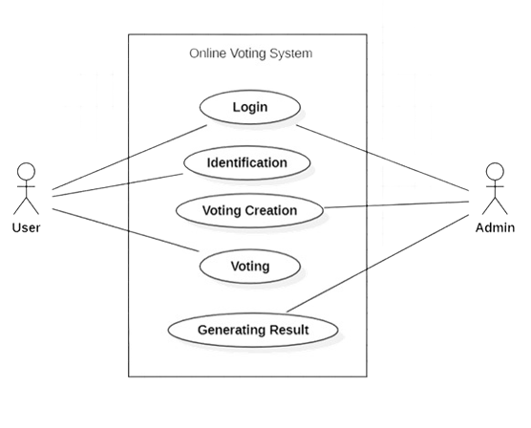
Use Case Diagram

Slide 11
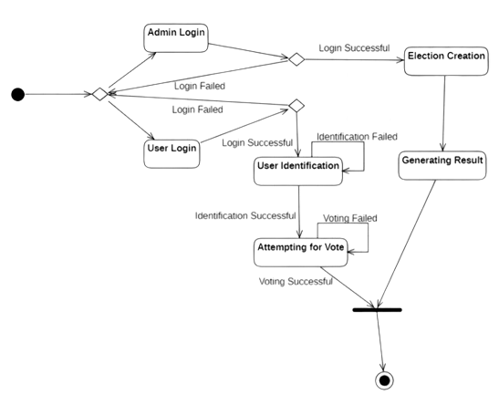
State Diagram

Slide 12
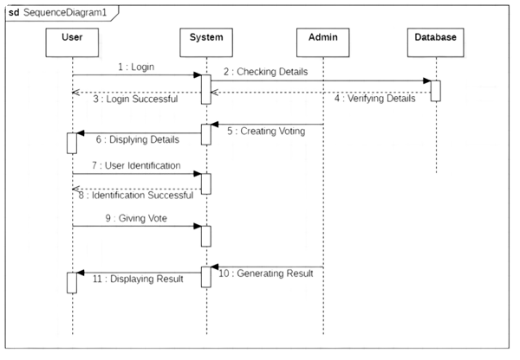
Event Trace Diagram

Slide 13
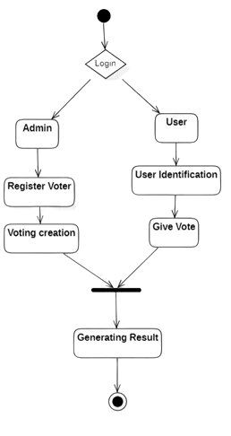
Activity Diagram

Slide 14
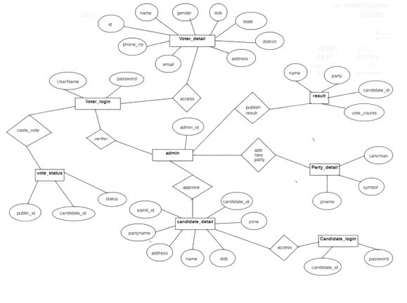
Entity Relation Diagram

Slide 15
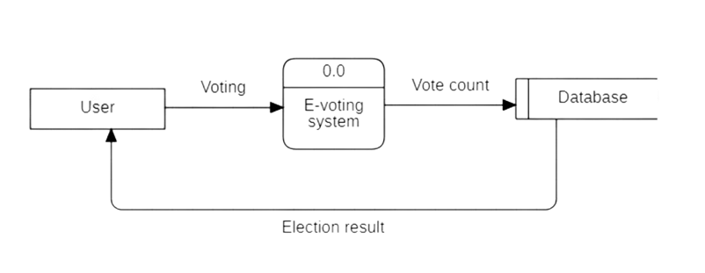
Data Flow Diagram Level-0

Slide 16
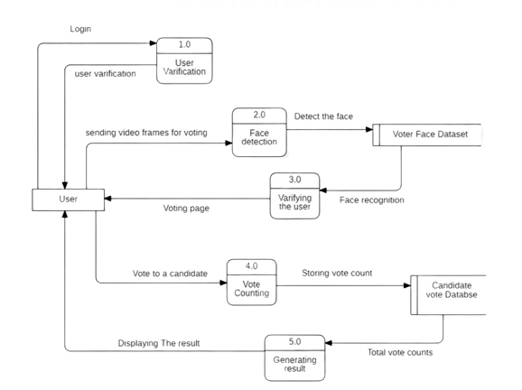
Data Flow Diagram Level-1

Slide 17
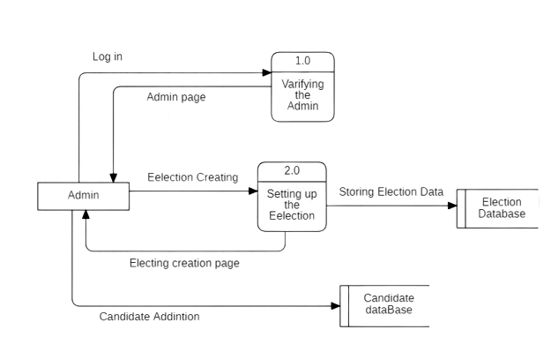
Data Flow Diagram Level-1

Slide 18
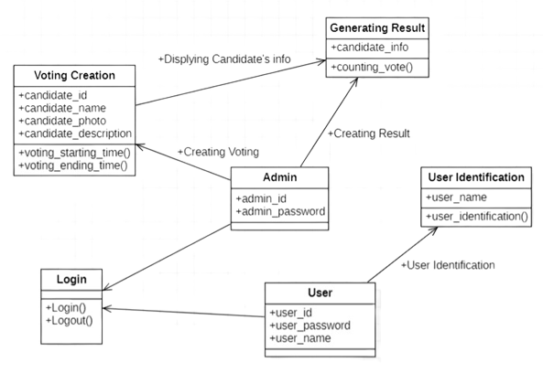
Class Diagram

Slide 19
Modules
Login Module
Voting Module
Voting Creation Module
Voting Result Module
User Identification Module

Slide 20
Login Module
This module describes about login functionality in which there are two types of login are there
1.Voter login
2.Admin login

Slide 21
User Identification Module
This module system will authenticate user that particular user is valid or not. This authentication will be done by face recognition system where user will have to scan their face to access the voting portal in order to make voting system crystal clear because due to this no other person can cast vote in place of a particular user.

Slide 22
Voting Module
In this module user can cast their votes. This module will describe a whole page where there will be list of candidates were noted with their symbols .User will have to just click the button besides the candidate name. After clicking, one confirmation dialogue box will generated to confirm a vote.
All the votes that have been casted will be stored in a database which will use a blockchain technology to store to a data so that no third party can alter the upcoming result.

Slide 23
Voting Creation Module
In this module admin can create whole voting environment (i.e. arrange voting facility, specifies time of voting, add candidates that have stand, and records the entry that particular person has voted, etc.)

Slide 24
Voting Result Module
This module is the main module of our system as it gives the result of the voting. As we have used blockchain technology our votes will not be not be altered and thus purity maintains and the proper candidate will be won.

Slide 25
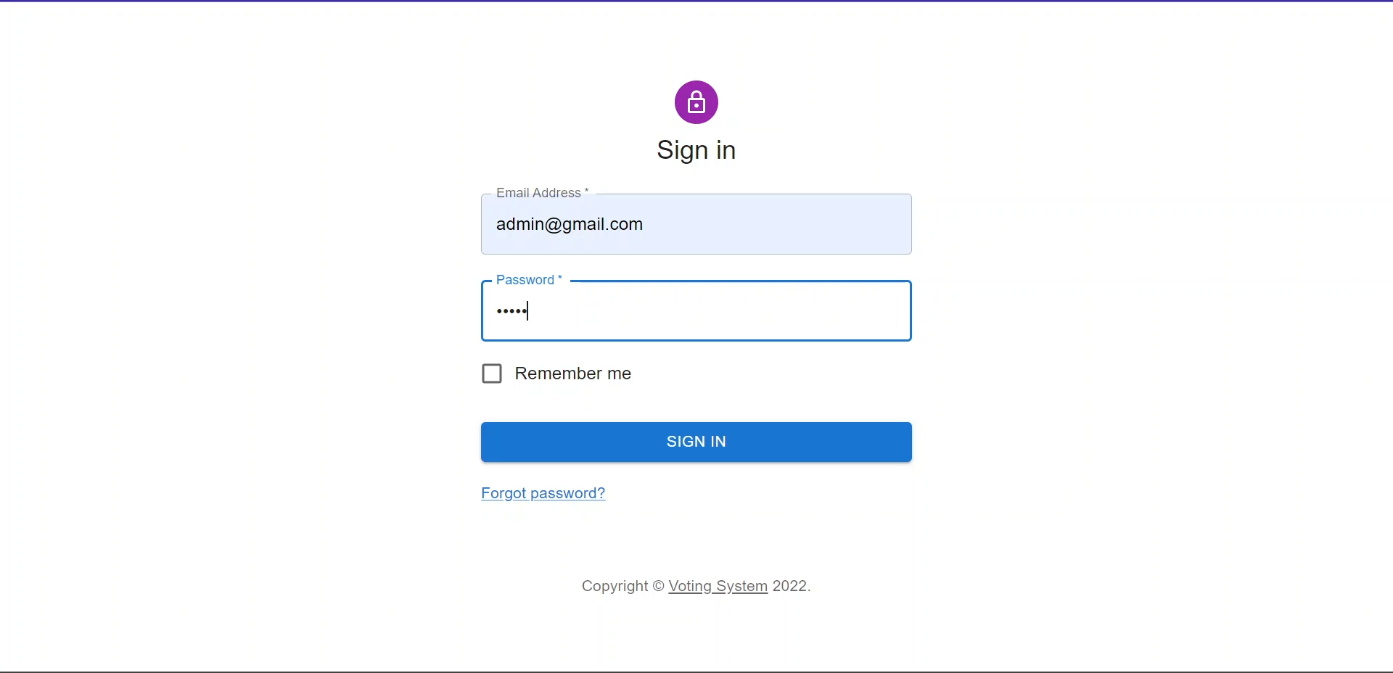
Implementation

Slide 26
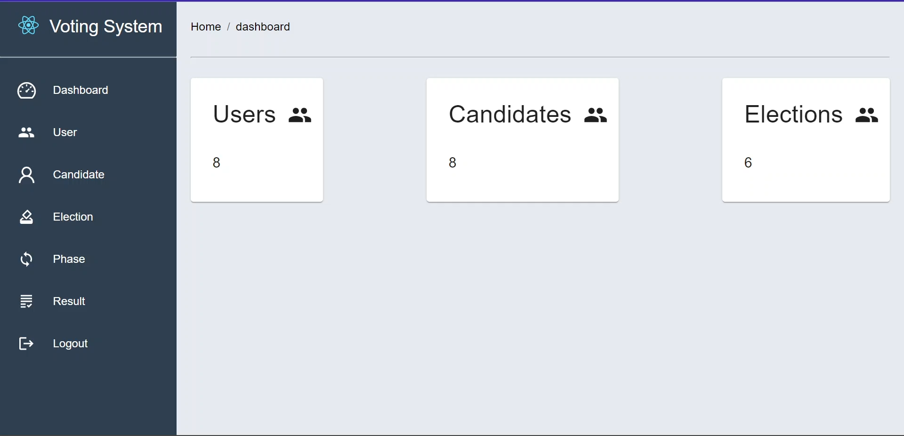
Dashboard

Slide 27
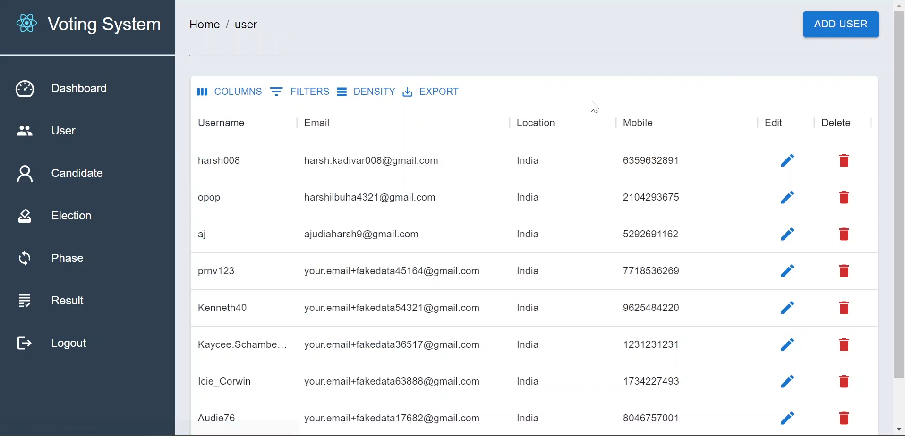
View Users

Slide 28
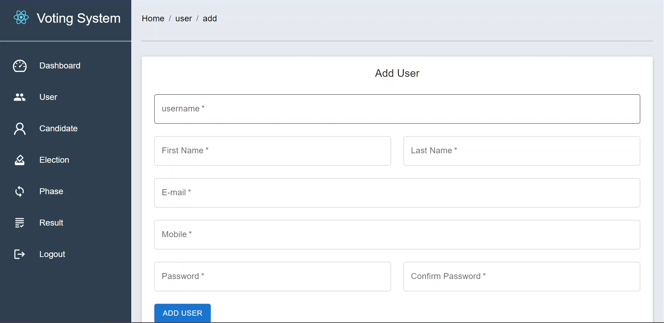
Add User

Slide 29
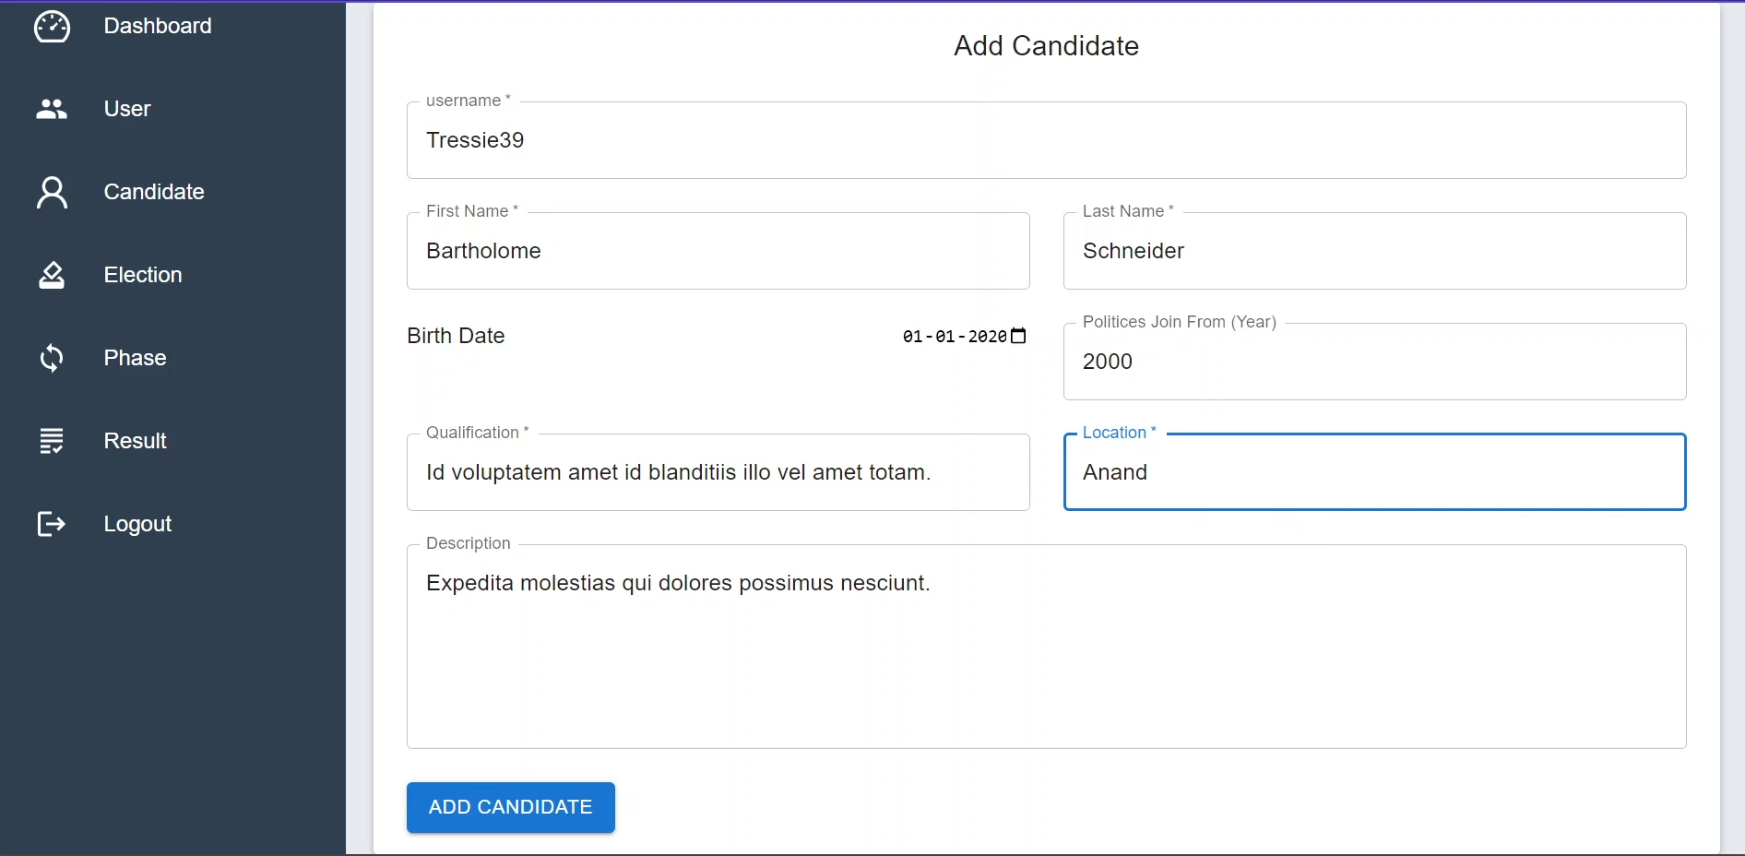
Add Candidates

Slide 30
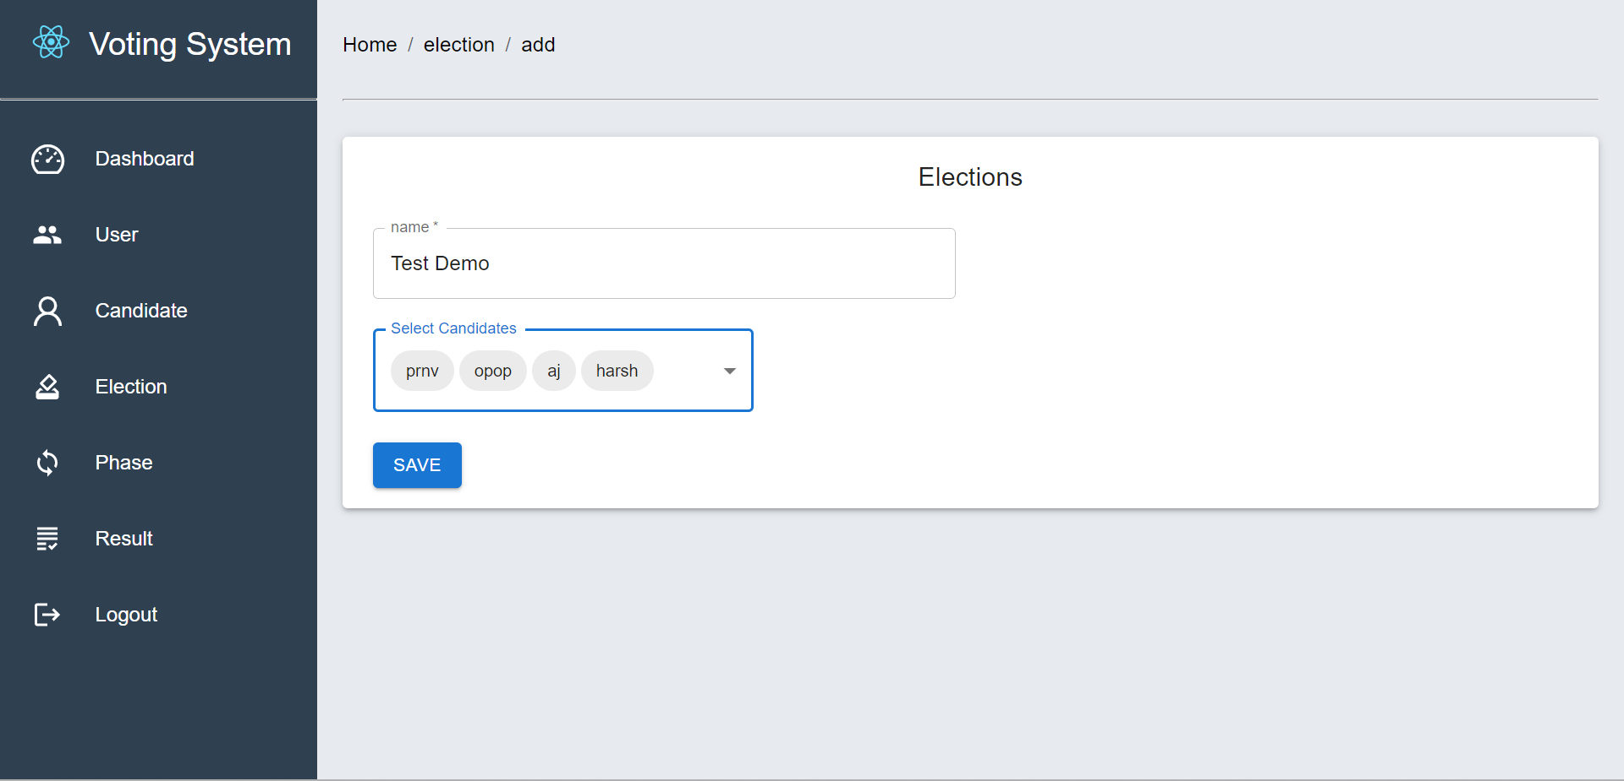
Add Election

Slide 31
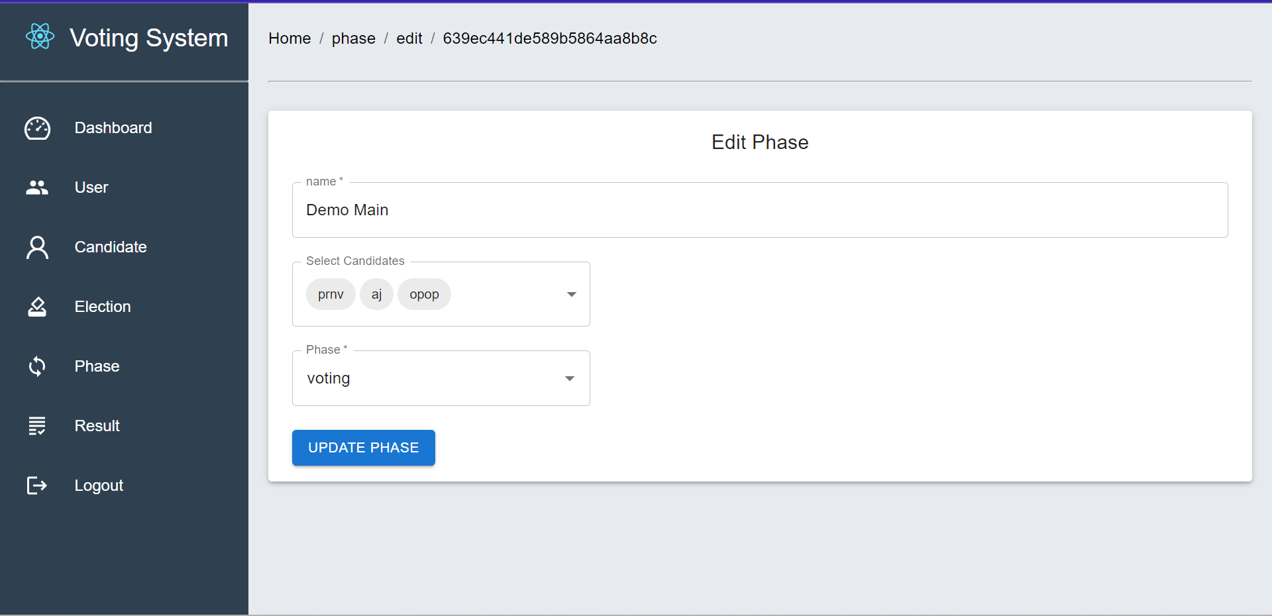
Edit Phase

Slide 32
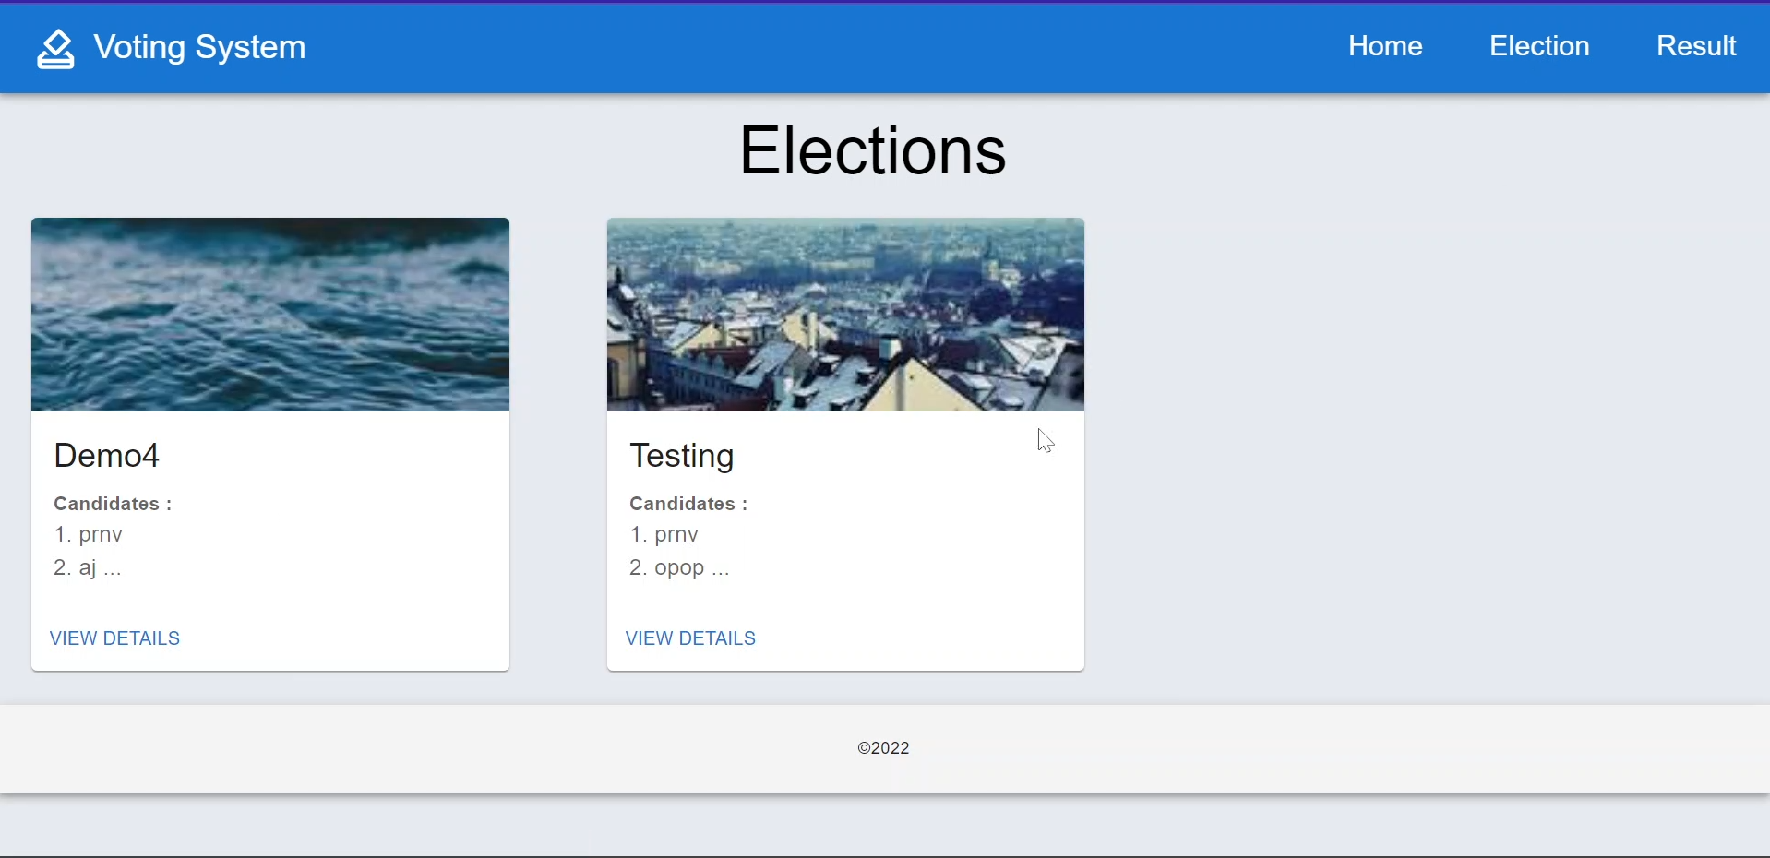
View Election

Slide 33
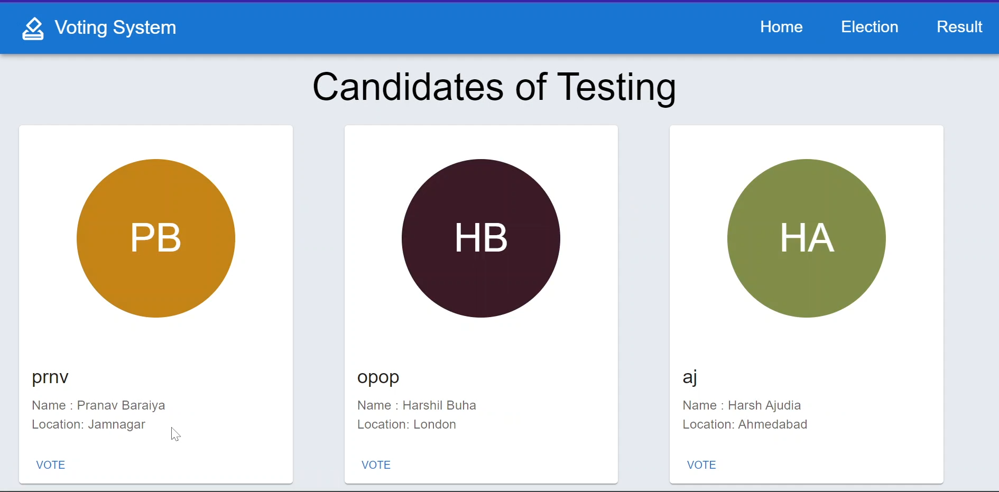
Candidate of Election

Slide 34
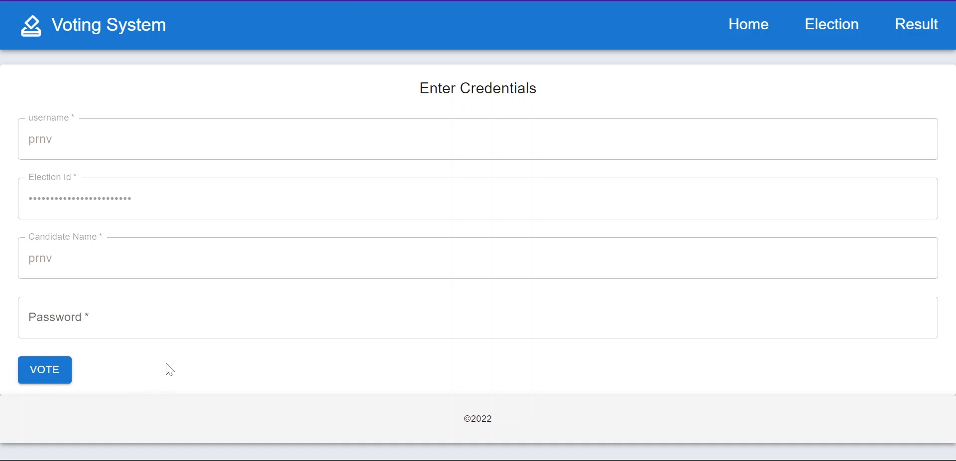
Login User

Slide 35
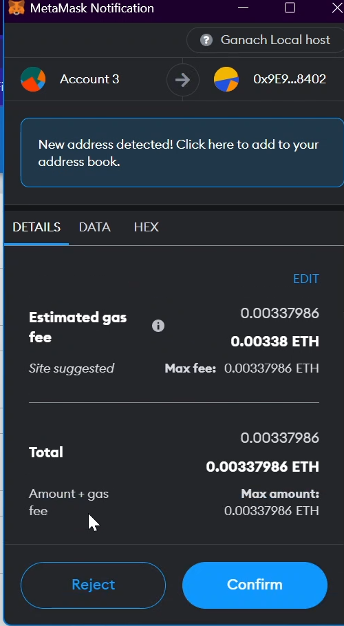
Metamask Transaction

Slide 36
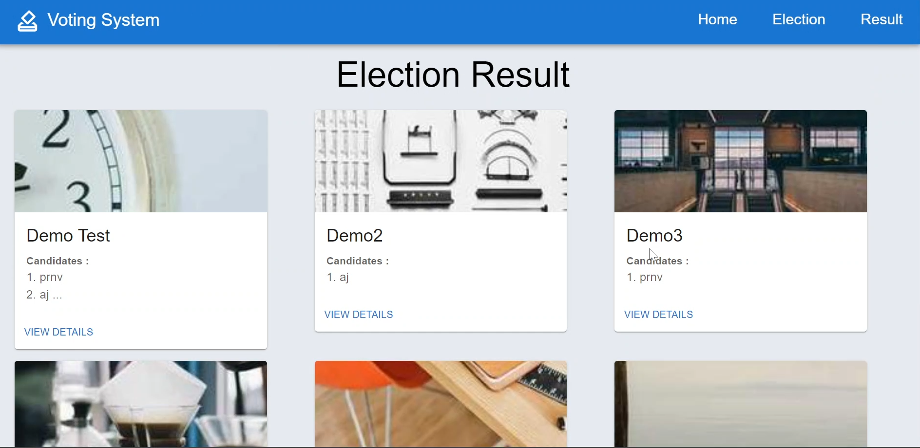
Result of Election

Slide 37
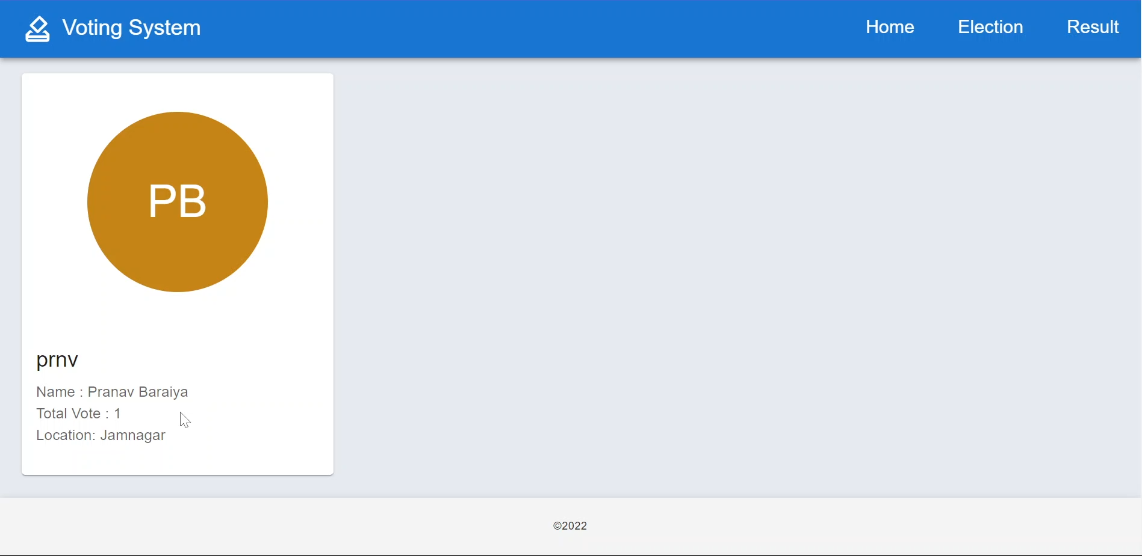
Result of Candidates

Slide 38
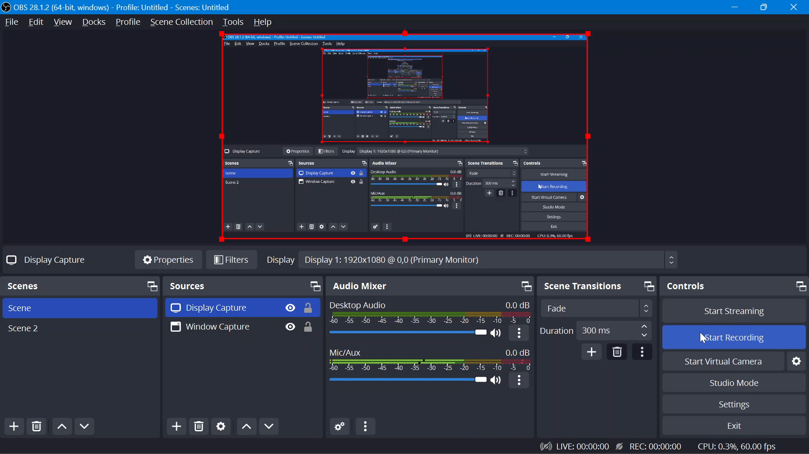
Demonstration

Slide 39
References
[1] Raghav Chhabra, Uday Vohra, Vishrant Khanna, Aditya Verman, Poonam Tanwar, Brijesh Kumar, The Next Gen Election: Design and Development of E-Voting Web Application, Issue 10-12 June 2020, IEEE
[2] Ramya Govindaraj, P Kumaresan, K. Sree harshitha, Online Voting System using Cloud, Issue 24-25 Feb. 2020, IEEE
[3] Bhushan M. Pawar, Sachin H. Patode, Yamini R. Potbhare, Nilesh A. Mohota, An Efficient and Secure Students Online Voting Application, Issue 8-10 Jan. 2020, IEEE
[4] Mrunal Annadate, Online Voting System Using Biometric Verification, Issue April 2017, ResearchGate
[5] Rajalakshmi Krishnamurthi , A Brief Analysis of Blockchain Algorithms and Its Challenges, Issue January 2021, ResearchGate
[6] Pranav KB, Manikandan J, Design and Evaluation of a Real-Time Face Recognition System using Convolutional Neural Network,Issue 2019, elsevier

